Slide 1
SC2001
Project 2
</
/>
SCS5 Team 1
Kiersten, Nicholas, Mythili

Slide 2
</Table of Contents
{01}
{02}
{03}
Adjacency
Matrix
Adjacency Lists
Comparison
Which is better and in what circumstances
Using an Array for the priority queue
Using a minimizing heap for the priority queue

Slide 3
{01}
Adjacency
Matrix

Slide 4
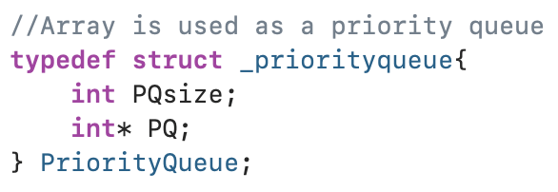
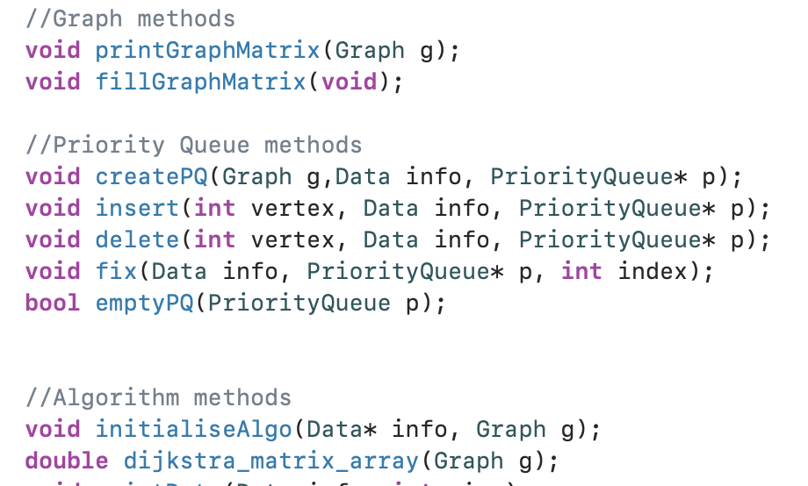
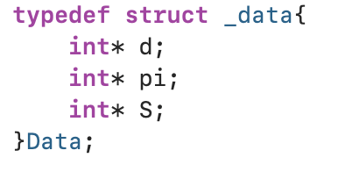
</Adjacency Matrix: Code
Notes:
//insert of a vertex is only done directly after the same vertex is deleted
//that vertex is stored at index PQsize (last index of priortiy queue is stored at index PQsize-1
//so we just have to increase the size by one (to include the vertex to be inserted), and call fix
//swap the vertex to be deleted with the last element of the priority queue
// then reduce the size of the queue by one to exclude it
//call fix
Fix uses selection sort to sort the priority queue
Insert and delete call fix after modifying the value of PQsize

Slide 5
</Adjacency Matrix: Code
Delete Operation
Fix
Always first element is deleted
Swap 2 and 1: [2, 4, 5, 3, 1]
Reduce size by 1: [1, 4, 5, 3]
Call “fix” to reorder: [1, 3, 5, 4]
Priority Queue: [2, 3, 5, 4, 1]
Sort: [2, 3, 5, 4, 1] ⇔ [2, 3, 5, 1, 4]
Repeat
Sorted PQ: [1, 2, 3, 4, 5]
Insert Operation
Increase size by 1: [1, 3, 5, 4, 2]
Call “fix” to reorder: [1, 2,3, 5, 4]
Notes:
//insert of a vertex is only done directly after the same vertex is deleted
//that vertex is stored at index PQsize (last index of priortiy queue is stored at index PQsize-1
//so we just have to increase the size by one (to include the vertex to be inserted), and call fix
//swap the vertex to be deleted with the last element of the priority queue
// then reduce the size of the queue by one to exclude it
//call fix
Fix uses selection sort to sort the priority queue
Insert and delete call fix after modifying the value of PQsize

Slide 6
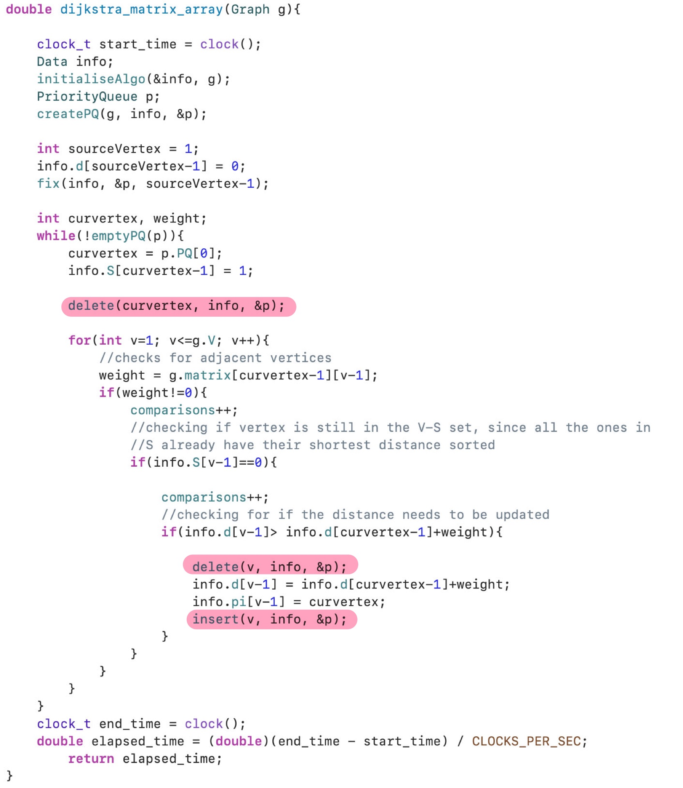
</Adjacency Matrix: Code

Slide 7
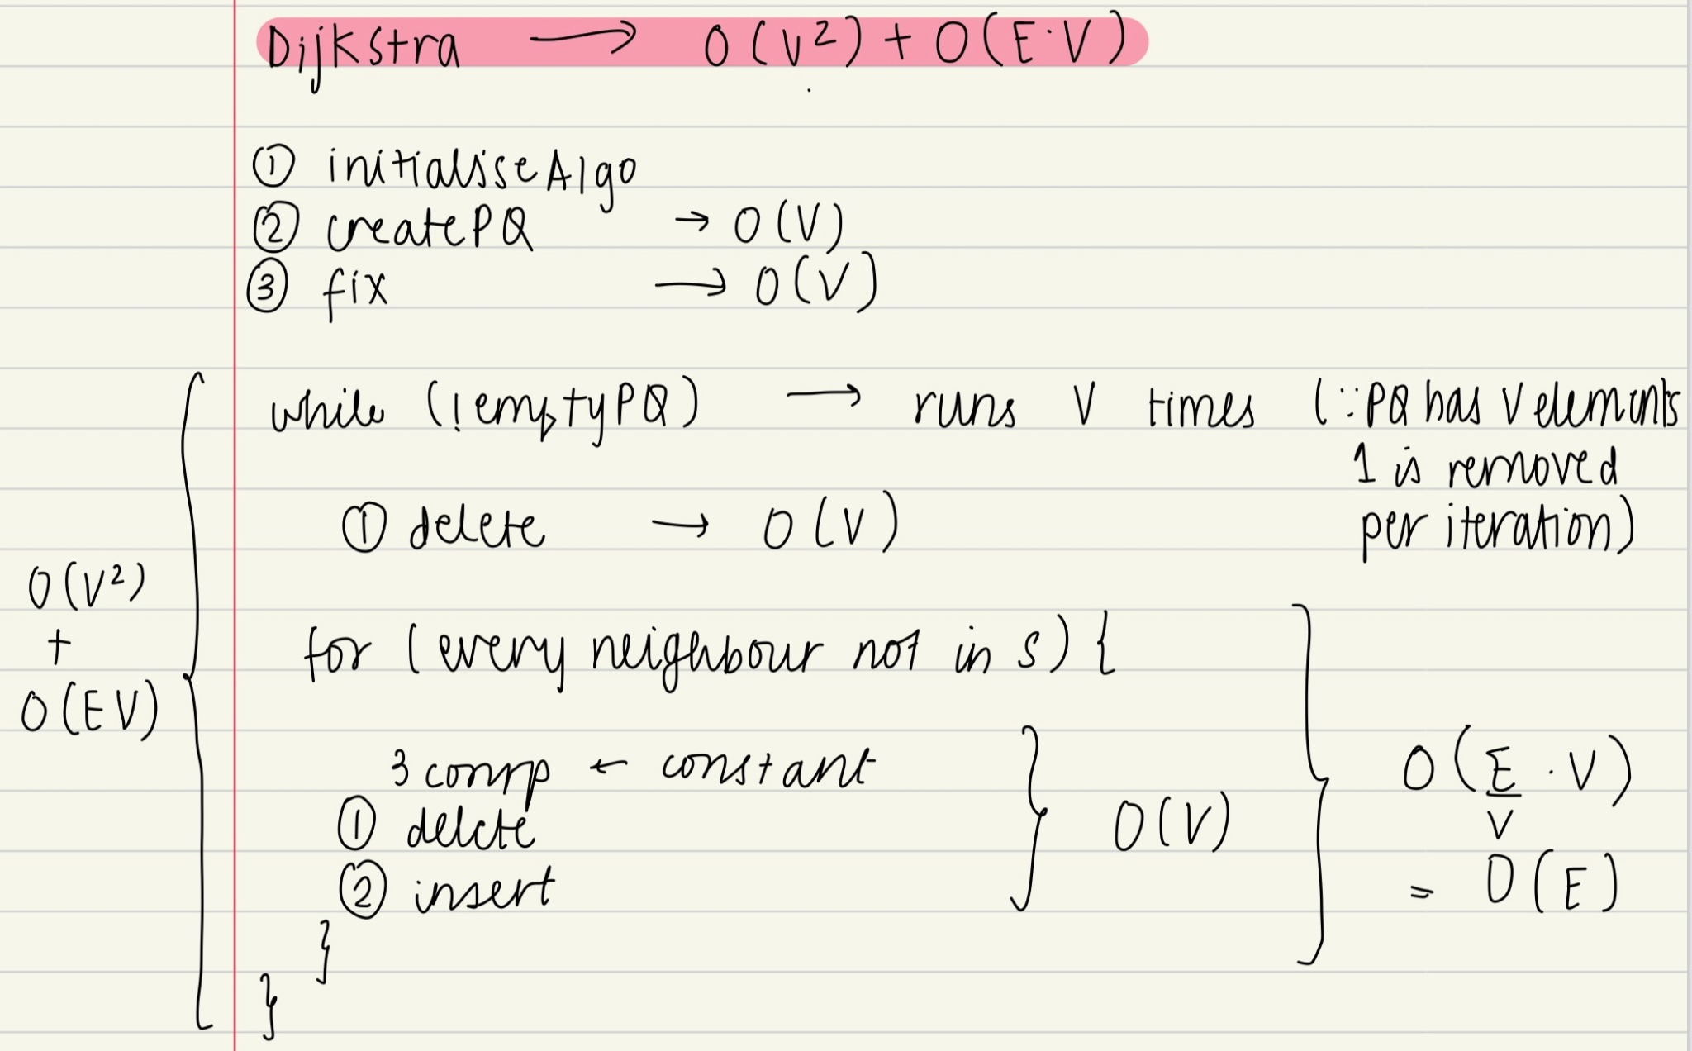
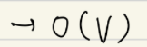
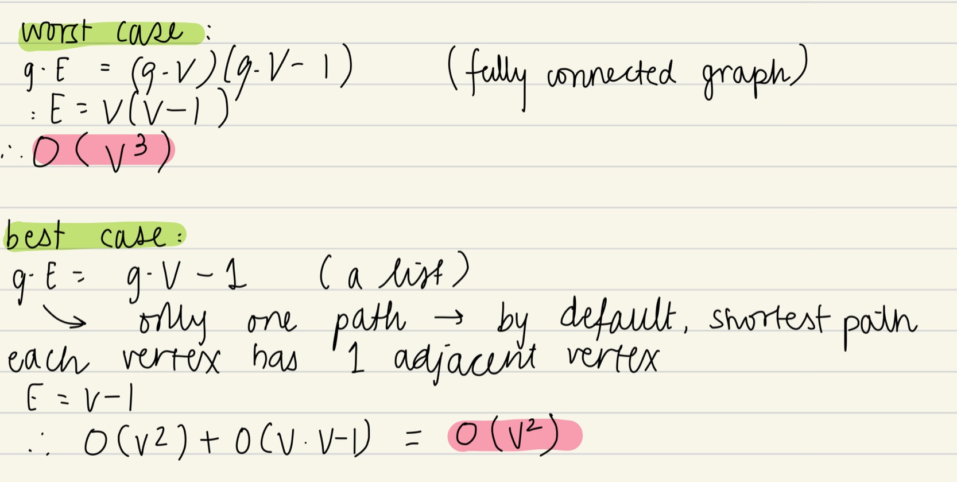
</Adjacency Matrix: Time Complexity
Notes:
Theoretical calculation of the time complexity of the Adjacency matrix with the array as priority queue.
The fix method performs selection sort on an array of size PQsize. The worst case value of PQsize is V and so the big-Oh time complexity of fix = O(V) Since delete and insert both call fix, their time complexities are also O(V)
Now for the whole algorithm,the methods initialiseAlgo, createPQ and fix which is called when d[source] is updated all have time complexity O(V)
In the while loop, we call delete once when we select the current vertex. And then for each vertex adjacent to current vertex not in S whose distance needs to be updated, we call delete and insert which combined have a time complexity of O(V). The number of neighbours has an upper bound of E/V which would be the average edges per vertex. SO the time complexity of the for loop becomes O(E) And the while loop is run V times. So the time complexity of the while loop becomes O(V square) for delete plus O(EV) from the for loop. Our worst case scenario is one where the number of neighbours is the most, which would occur in a fully connected graph, where E = V(V-1) And so worst case time complexity becomes O(V^3)
Best case has the least number of neighbours, so the graph is basically a linked list. So E = V - 1 and the time complexity is O(V^2)

Slide 8
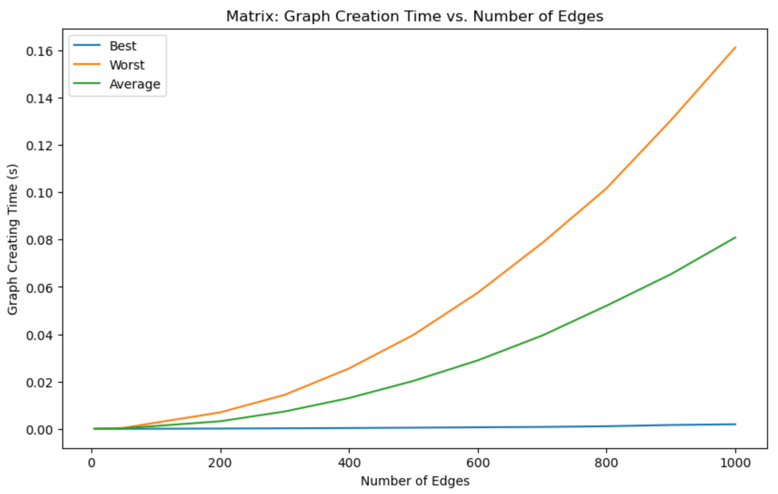
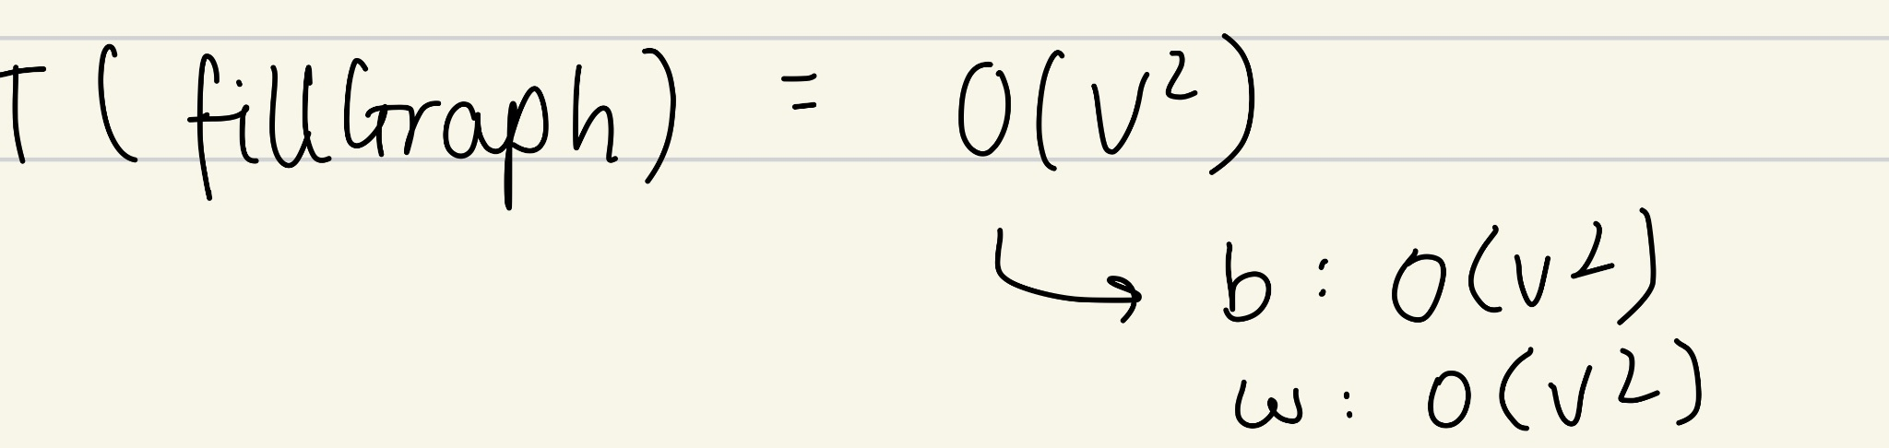
</Adjacency Matrix: Graph Creation Time
Vertices
Number of Vertices
Notes:
The complexity of the graph creation method is O(V^2) in the best and worst case since the entire VxV matrix has to be created and initialised to 0. Then changing the values of the cells to add the edges.
Hence in worst case this takes the longest as we must update all V^2 cells while in the best case, only V-1 cells need to be updated

Slide 9
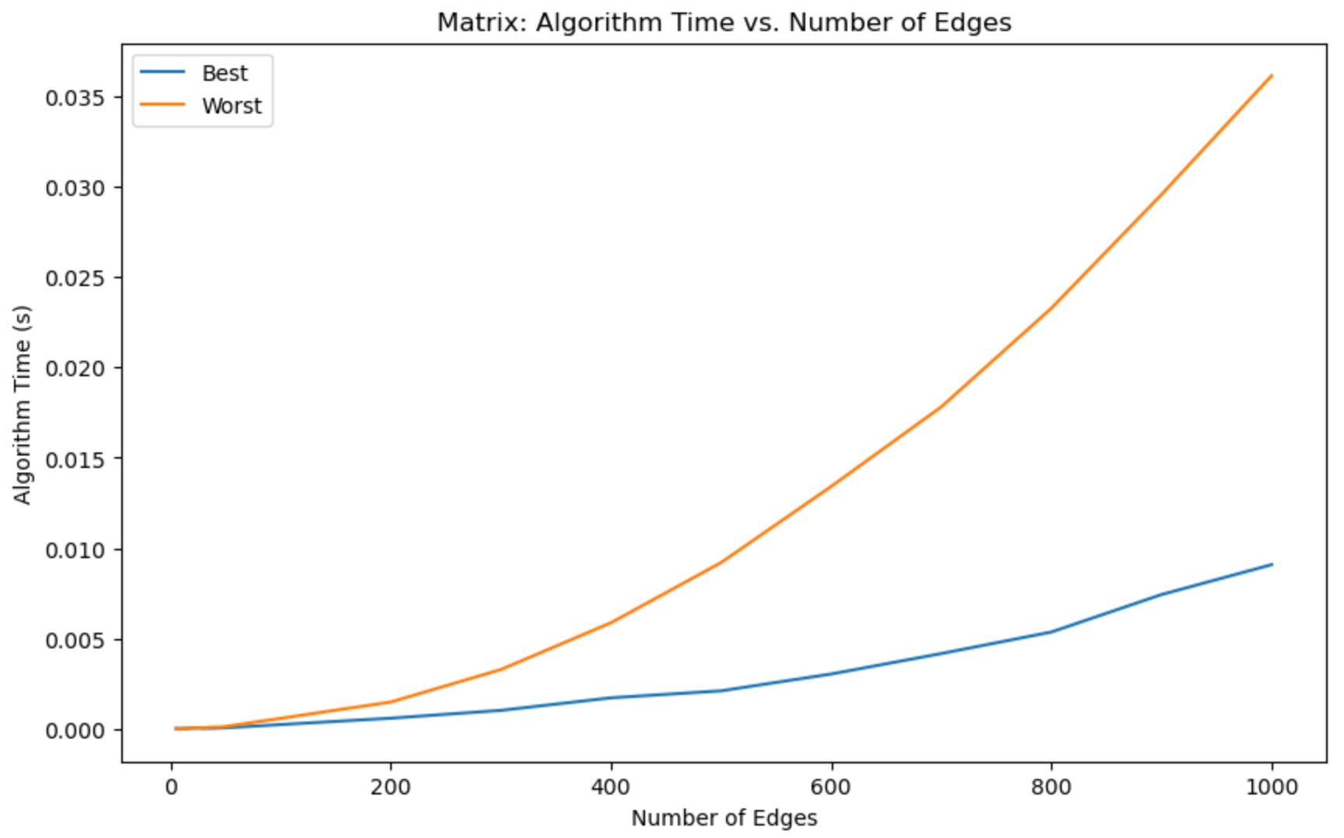
</Adjacency Matrix: Algorithm Time
Number of Vertices
Number of Vertices
Notes:
The algorithm running times is dependent on the number of times the for loop calls insert+delete In a fully connected graph, with more edges per vertex, the distance will have to be updated more often, hence the worst case grows much faster with a complexity of O(V^3) than the best case which runs at O(V^2) as mentioned before

Slide 10
{02}
Adjacency
Lists

Slide 11
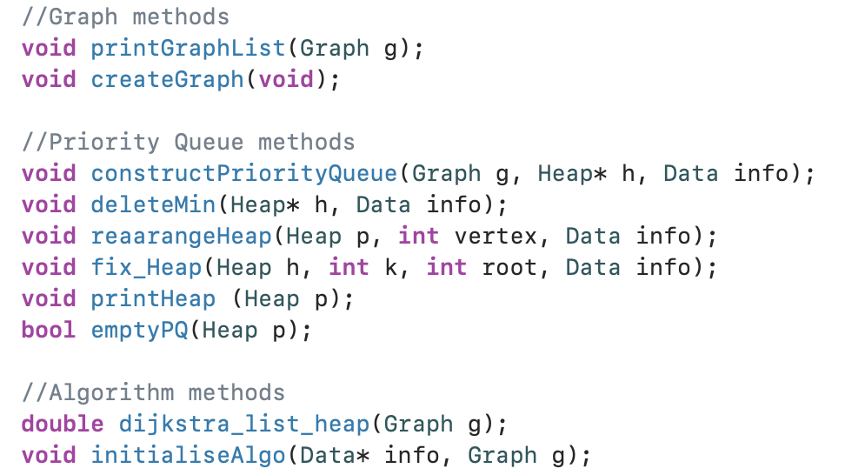
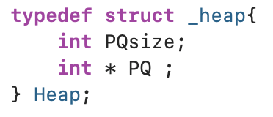
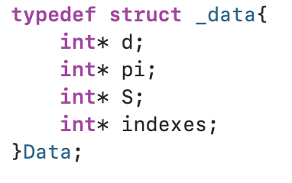
</Adjacency List: Code

Slide 12
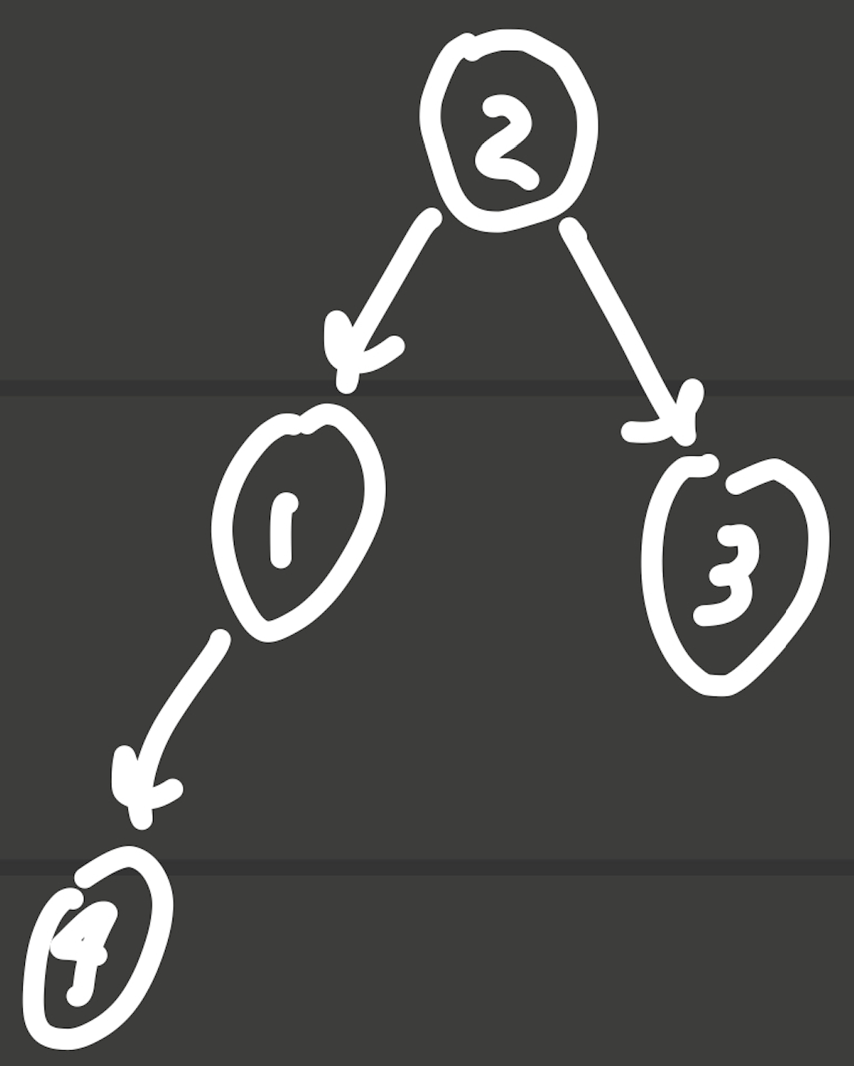
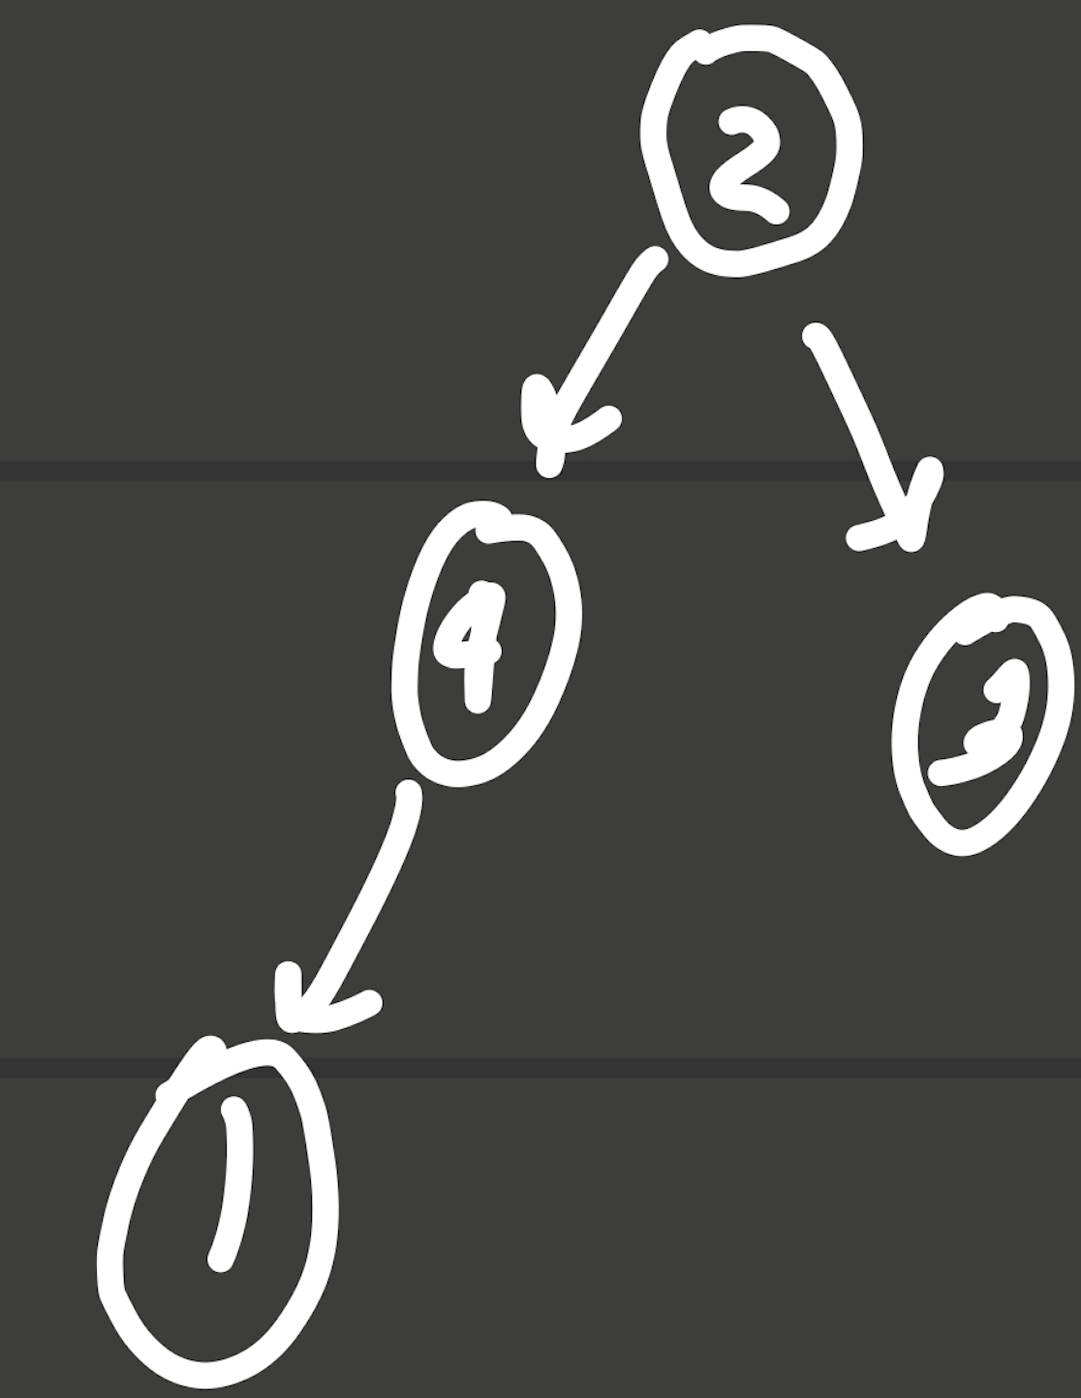
</Adjacency Lists: Code
RearrangeHeap Operation
Distance: [5, 3, 6, 8]
Initial Heap: [2, 1, 3, 4]
Updated distance of 4 to 4 : [5,3,6,4]
Compare “d” value of 4 in heap with parent (“d[1]”)
Swap: “d[4]” and “d[1]” (4 < 5)
Compare “d” value of 4 in heap with parent (“d[2]”)
Stop: “d[4]” and “d[1]” (4 > 1)
Distance: [5, 3, 6, 4]
Final Heap: [2, 4, 3, 1]
DeleteMin Operation
Distance: [5, 3, 6, 8]
Initial Heap: [2, 1, 3, 4]
Remove root (2) , replace with last element : [4,1,3,2]
Reduce size by one : [4,1,3]
Call fix_Heap : Distance: [5, 3, 6, 8]
Final Heap: [1, 4, 3]
->

Slide 13
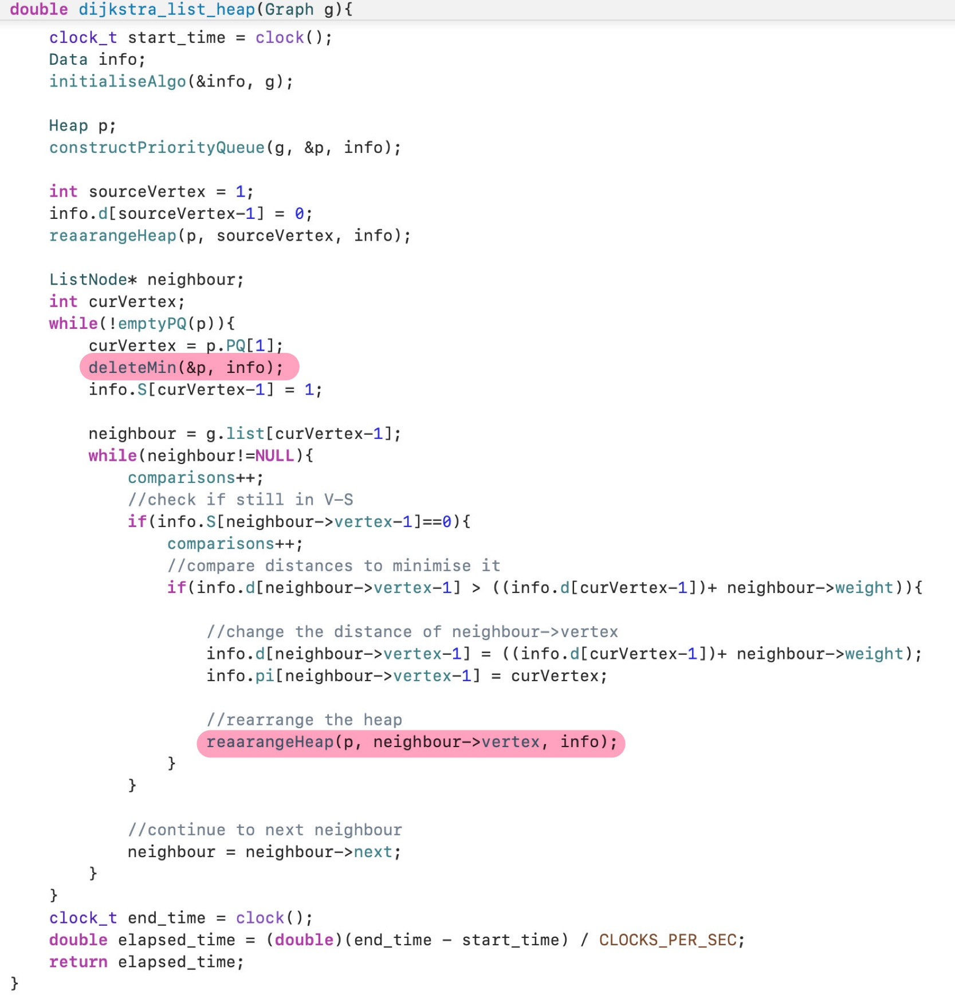
</Adjacency Lists: Code

Slide 14
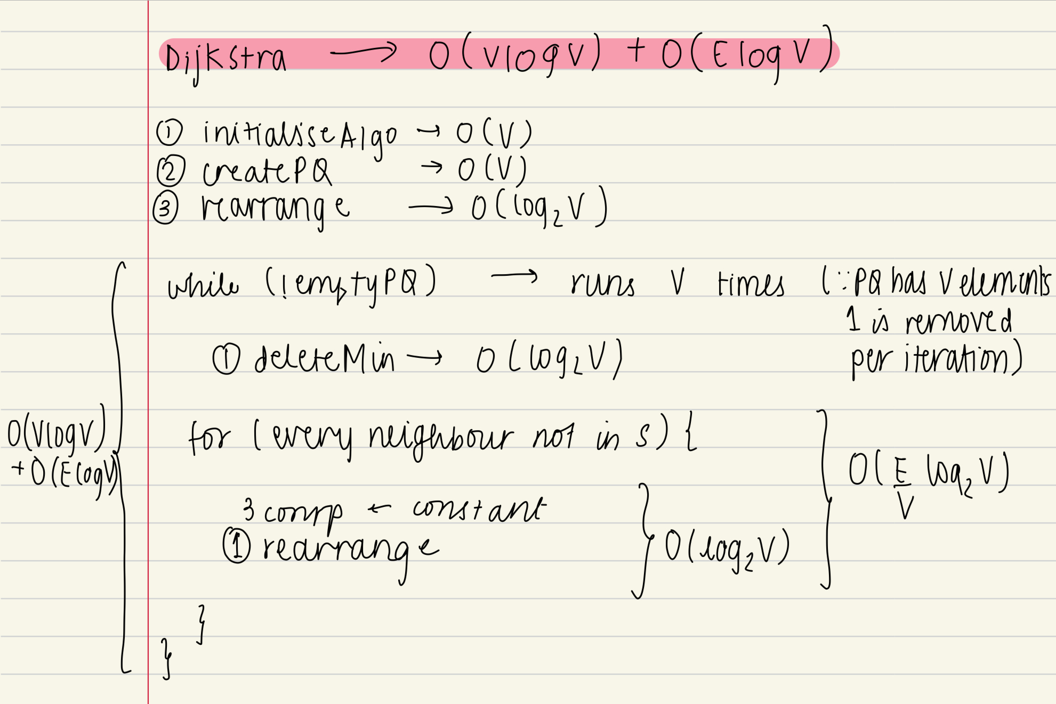
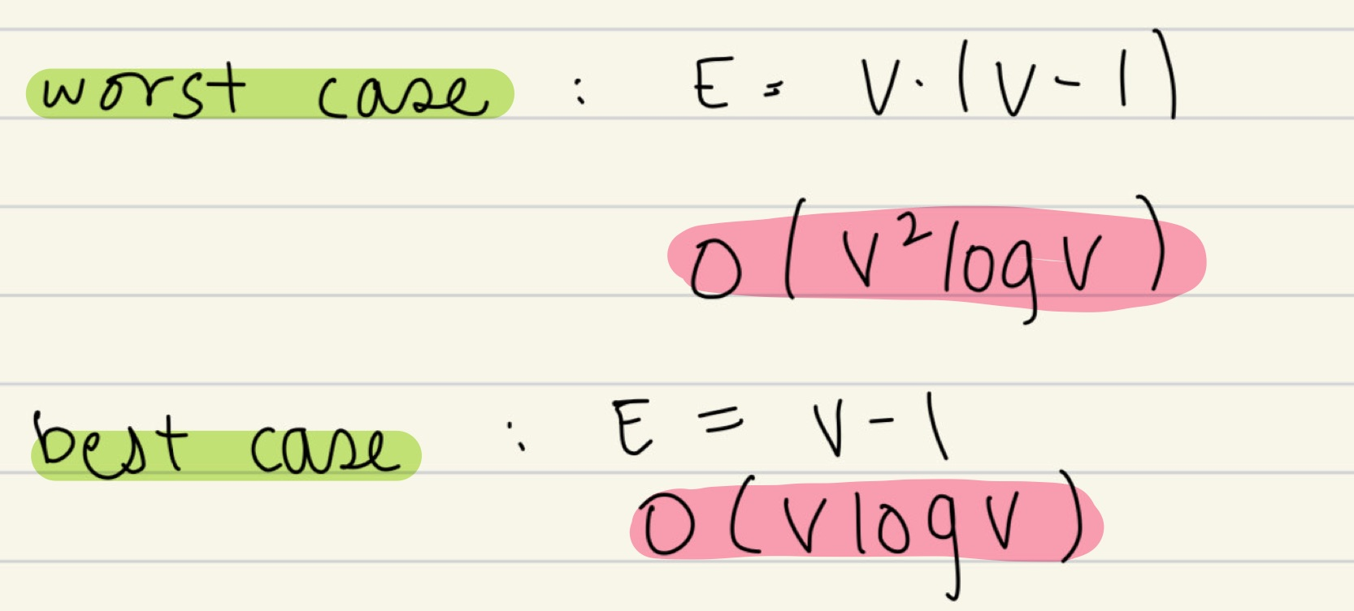
</Adjacency Lists: Time Complexity
Notes:
Theoretical calculation of the time complexity of the algorithm with Adjacency list with the heap as priority queue.
DeleteMin removes the first element of the heap and calls fix_Heap whose time complexity is O(logV)
The rearrange method shifts a vertex up a heap of size PQsize. The maximum number of times it can be shifted is equal to its depth in the heap, which in the worst case will be log(PQsize) and the largest value of PQsize is V. So the time complexity of rearrange is O(log(V)).
Now for the whole algorithm, initialiseAlgo, createPQ have complexity O(V) and rearrange which is called when d[source] is updated has time complexity O(logV)
In the while loop, we call deleteMin once when we select the current vertex. And then for each vertex adjacent to current vertex not in S, whose distance needs to be updated, we call rearrange which has a time complexity of O(log(V)).
The number of neighbours has an upper bound of E/V which would be the average edges per vertex. So the time complexity of the for loop becomes O(E by V logV) And the while loop is run V times. So the time complexity of the while loop becomes O(V log V) for deleteMin plus O(ElogV) for the for loop. In the worst case scenario e E = V(V-1) And so worst case time complexity becomes O(V^2logV)
Best case has E = V - 1 and the time complexity is O(VlogV)

Slide 15
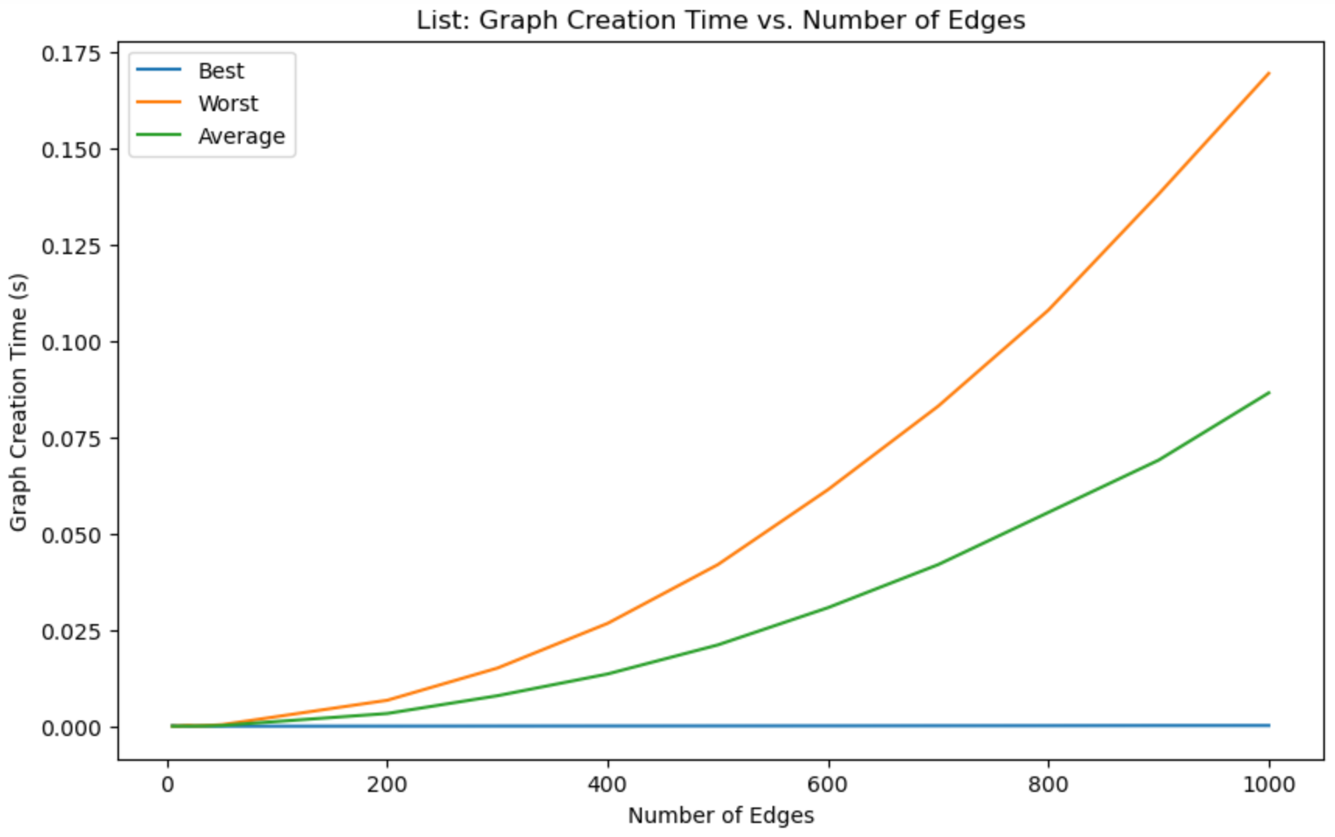
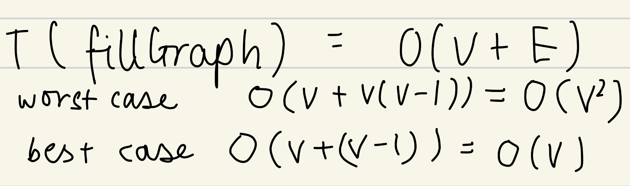
</Adjacency Lists: Graph Creation Time
Vertices
Number of Vertices
Notes:
The complexity of graph creation for adjacency list is O(V+E)
In the list the graph is created by adding a new node for each edge
In the worst case since E = V(V-1) the complexity is O(V^2)
while in the best case, V-1 cells need to be added and the time complexity is O(V) or linear as the graph shows

Slide 16
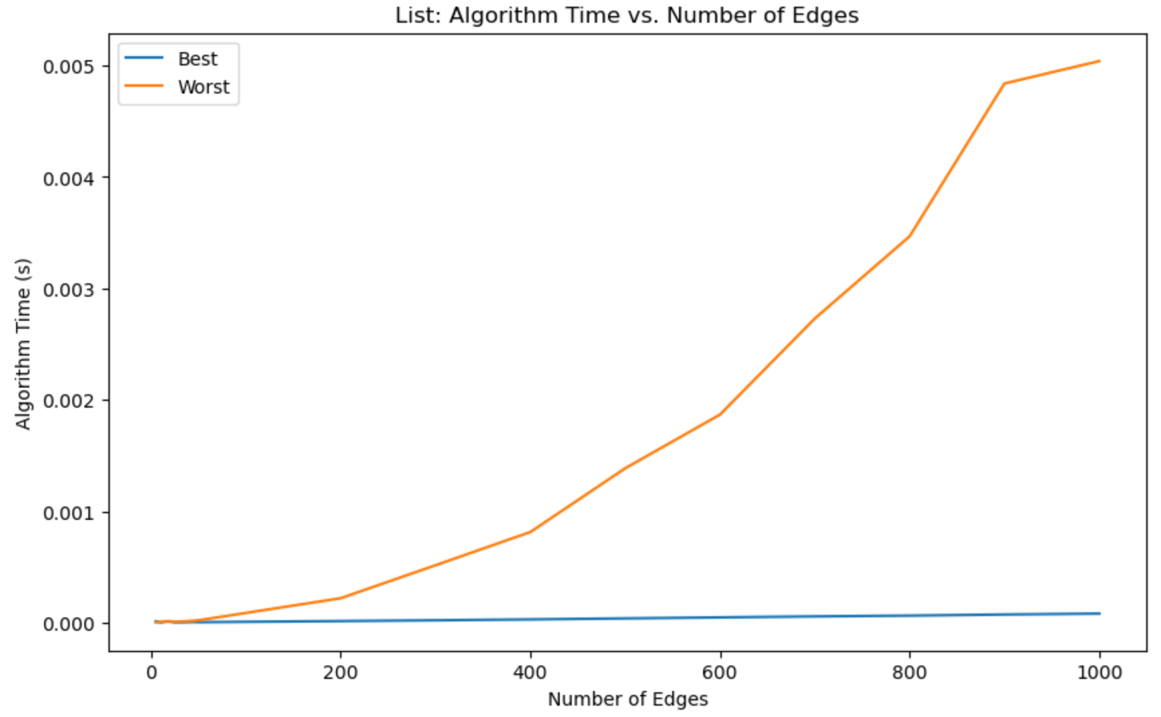
</Adjacency Lists: Algorithm Time
Number of Vertices
Number of Vertices
Notes:
The algorithm running times is dependent on the number of times the for loop calls rearrange
In a fully connected graph, with more edges per vertex, the distance will have to be updated more often, hence the worst case grows much faster with a complexity of O(V^2 logV) than the best case which runs at O(VlogV) as mentioned before

Slide 17
{03}
Comparison

Slide 18
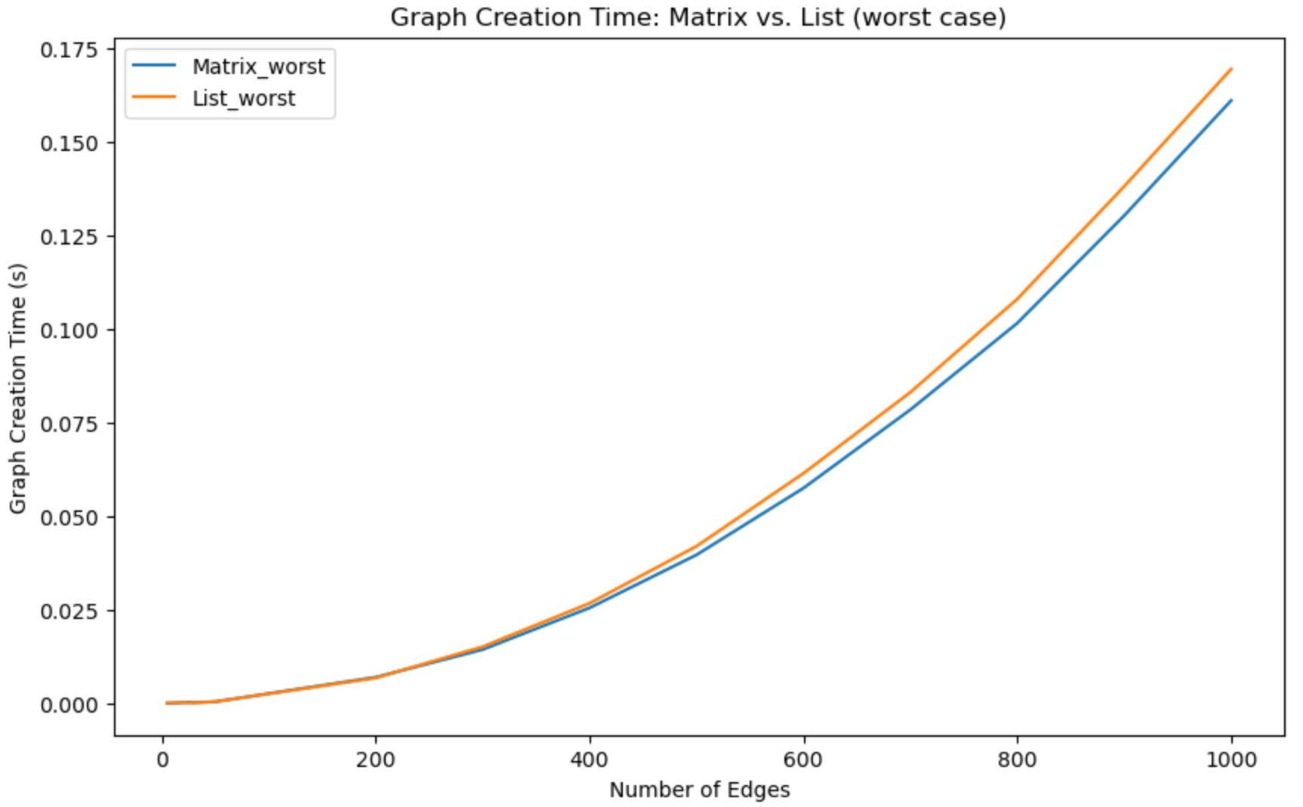
</Comparison: Graph Creation Time (worst)
Number of Vertices
Notes:
Both are quite similar Same time complexity O(V2)

Slide 19
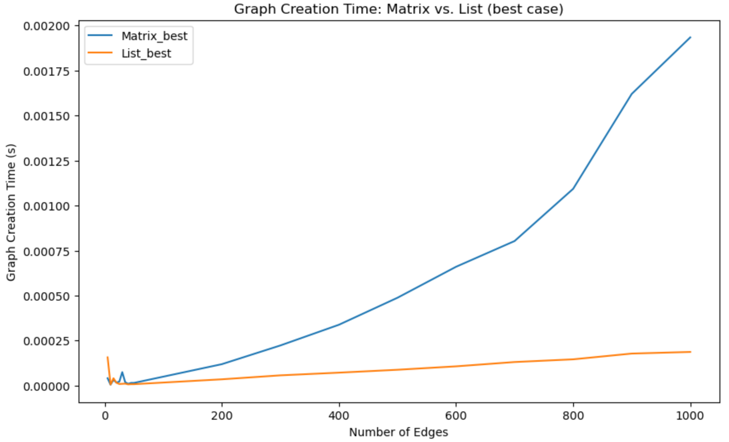
</Comparison: Graph Creation Time (best)
Number of Vertices
Notes:
As the number of edges increases, the graph creation time increases at a much faster rate for the adjacency matrix as compared to the adjacency lists.
Matrix O(V^2)
List O(V) hence linear

Slide 20
</Comparison: Graph Creation Time
For the worst case, both have the same time complexity.
For the best case, Adjacency Lists has a much better time complexity.
Conclusion: Adjacency Lists is preferred.
Number of Vertices
Number of Vertices

Slide 21
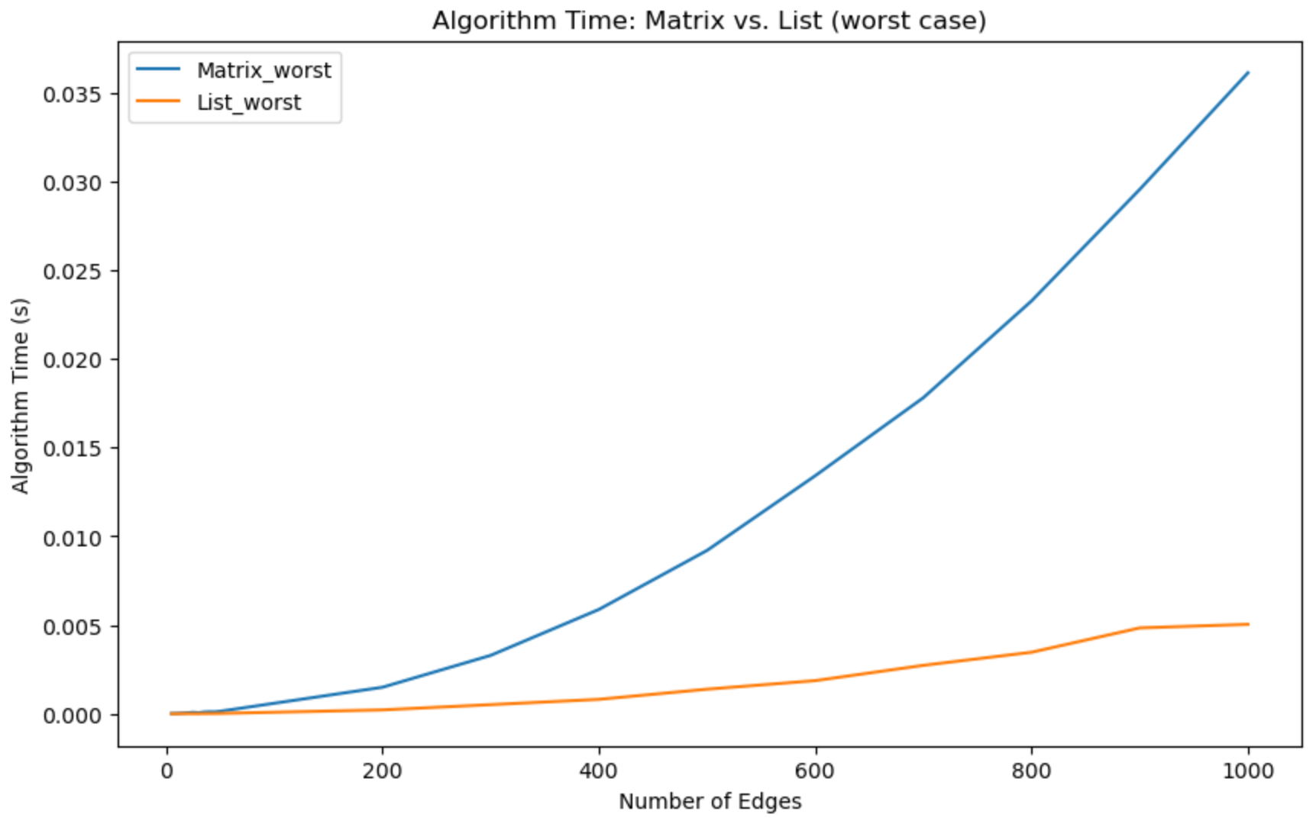
</Comparison: Algorithm Time (worst)
Number of Vertices
Notes:
Matrix: O(v3)
List: O(v2 log v)

Slide 22
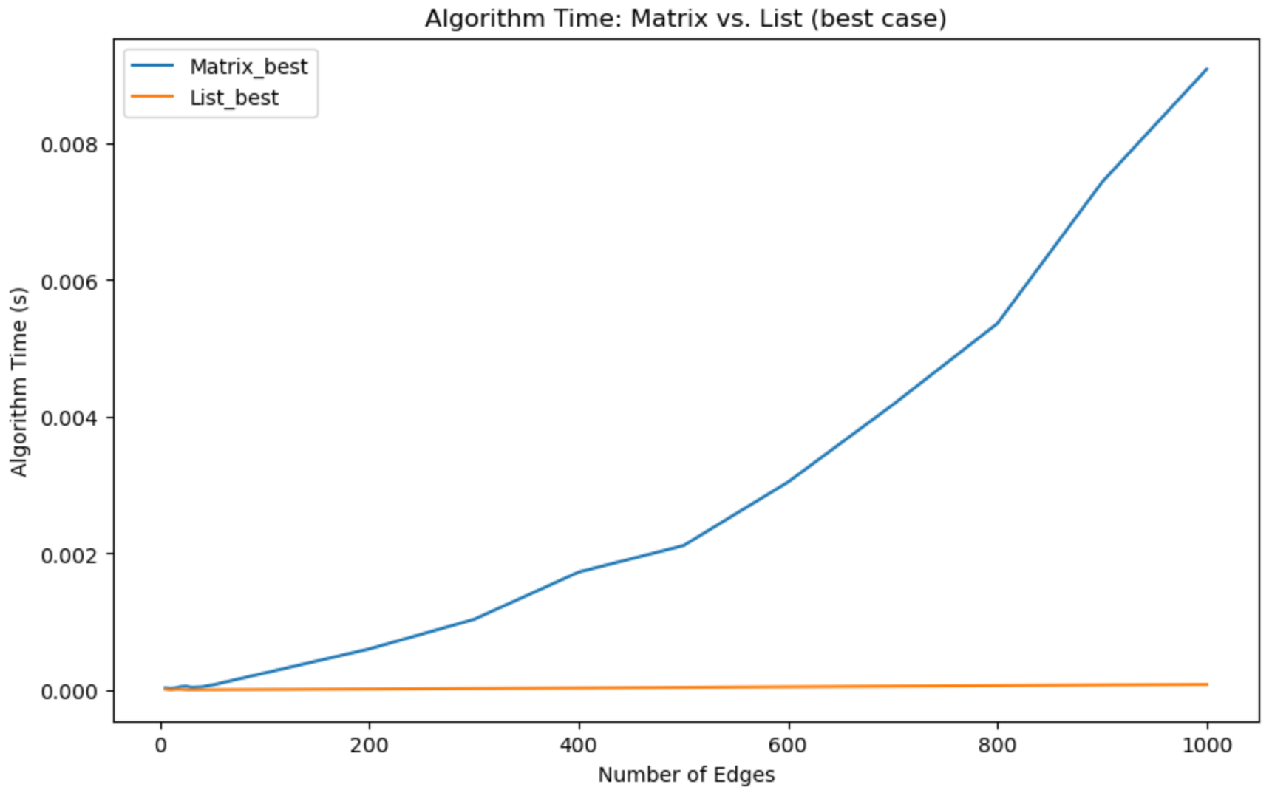
</Comparison: Algorithm Time (best)
Number of Vertices
Notes:
Matrix: O(v2)
List: O(v logv)

Slide 23
</Comparison: Algorithm Time
For both the worst case and best case, Adjacency List takes much lesser time for the Dijkstra’s algorithm as compared to Adjacency Matrix.
Number of Vertices
Number of Vertices

Slide 24
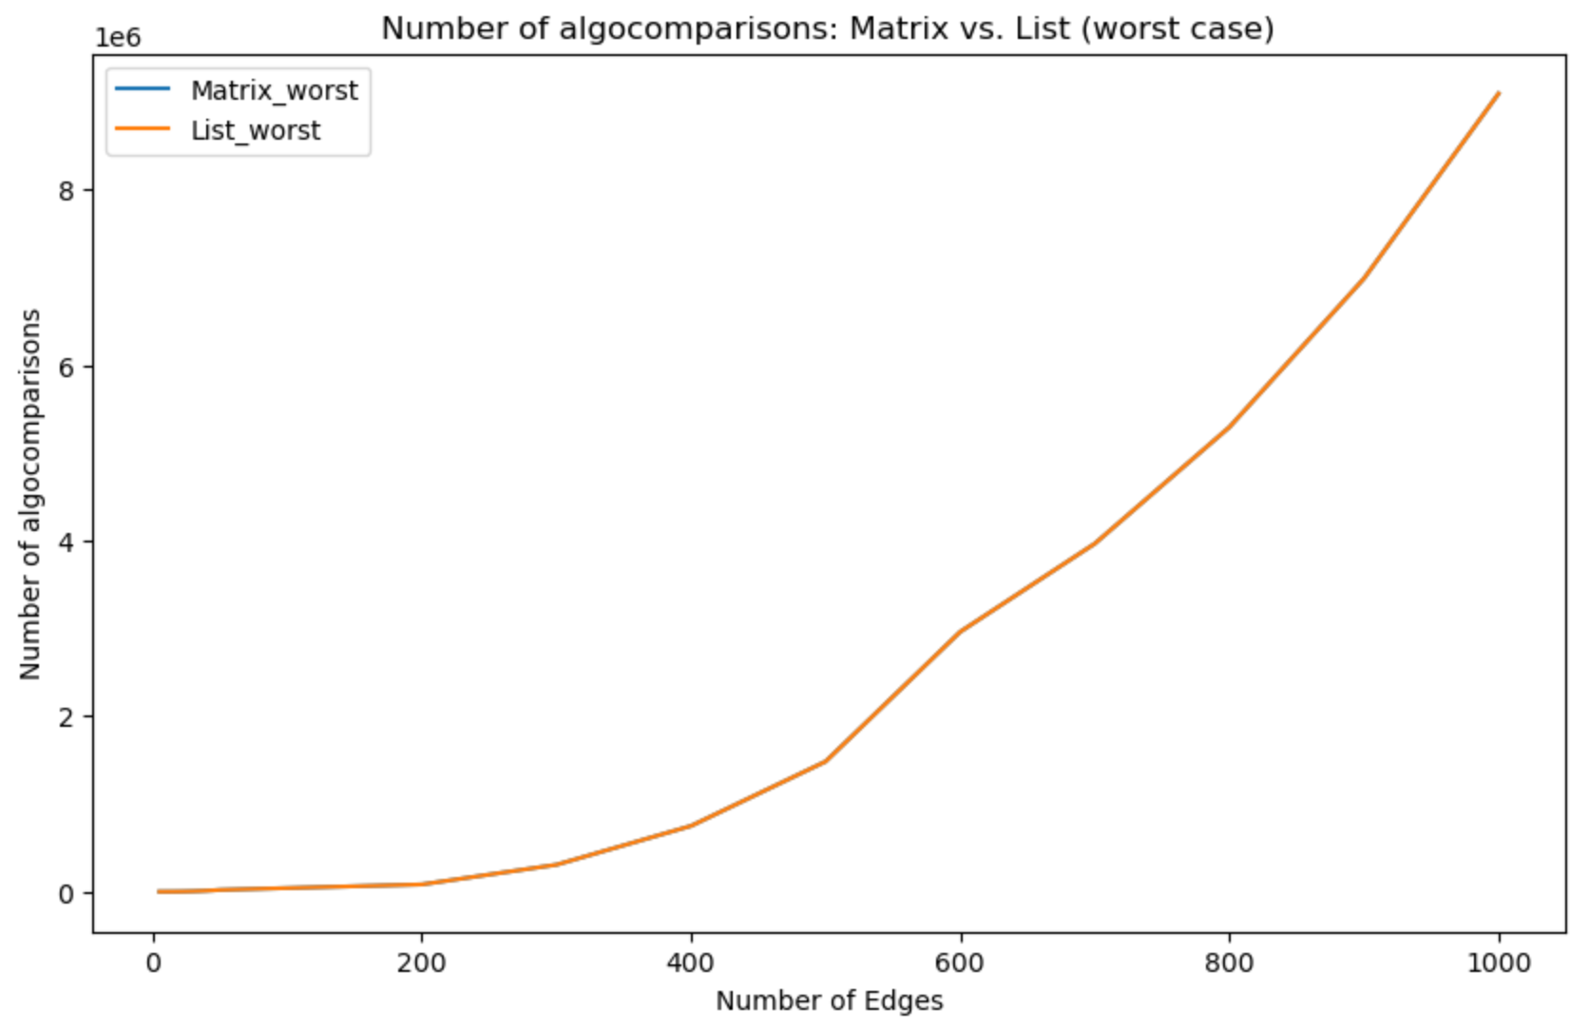
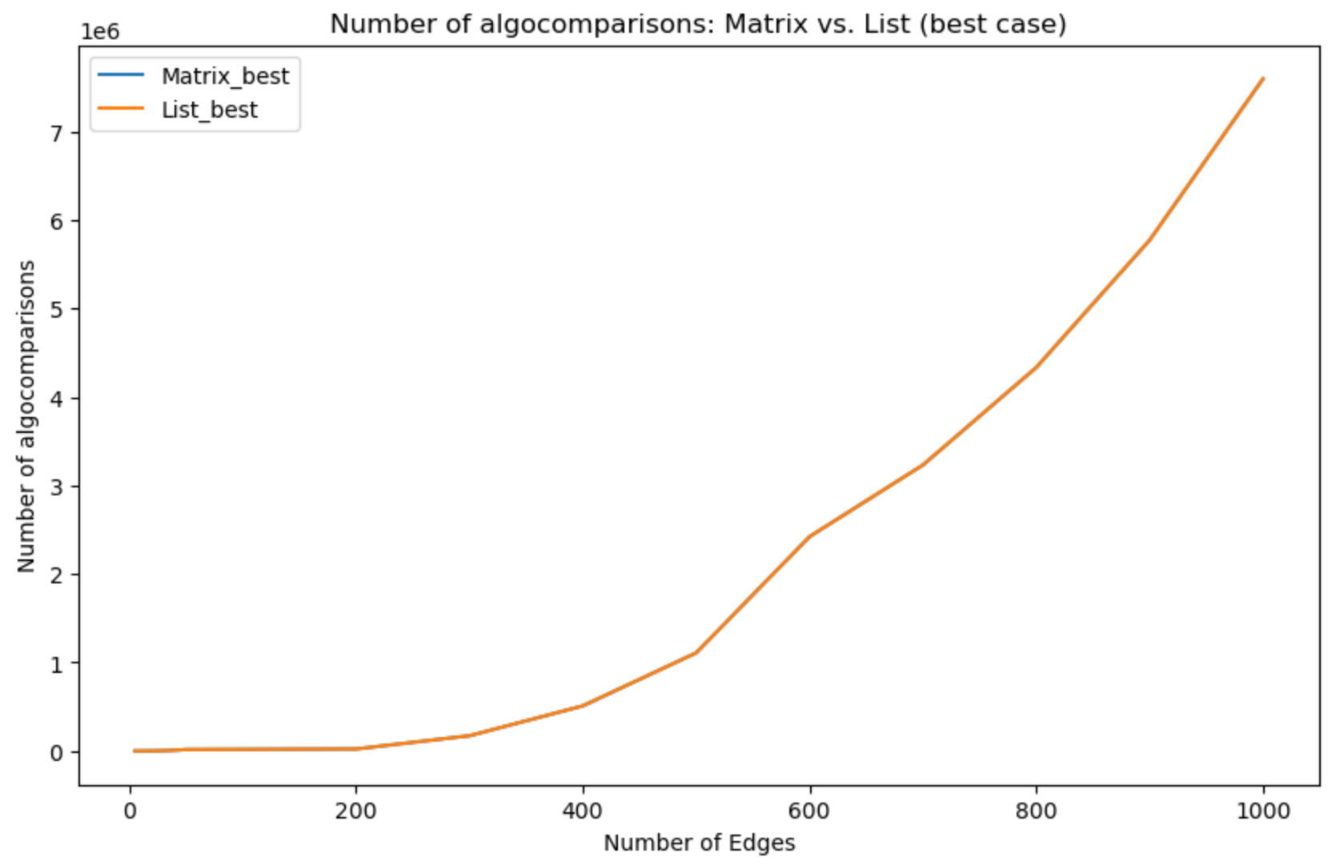
</Comparison: Number of Comparisons
Number of Vertices
Number of Vertices
Same number of comparisons for checking whether the shortest distance needs to be updated - difference lies in the updating.
Notes:
Number of comparisons to check if the distance of a vertex needs to be updated are the same . Hence we can see that the algorithm times depend on the method we use to update priority queue. And the heap has a much better performance as seen before than the array.

Slide 25
</Conclusion
Using an array of adjacency lists with a minimizing heap as the priority queue is a better implementation for both the best and worst cases.

Slide 26
THANK YOU!

Slide 27
</New operating system design
Mars is actually a cold planet
Venus is a very hot planet
Mars
Venus
Earth
Jupiter
Saturn
Earth is the planet with life
It doesn’t have a solid surface
It was named after a Roman god

Slide 28
</New operating system design
Jenna Doe
Kelly Smith
Venus is a very hot planet
Earth is the planet with life
Juan Jones
John Martin
Mars is full of iron oxide dust
Mercury is a small planet

Slide 29
</New operating system design
Them
Us
Mercury is small
Jupiter is a big planet
Venus is a hot planet
Saturn is a gas giant
Earth harbors life
Neptune is an ice giant
Mars is very cold
Pluto is a dwarf planet

Slide 30
</New operating system design
Problem
Process
Solution
{01}
{02}
{03}
Analysis
Evaluation
Synthesis
Earth is the planet with life
Mars is full of iron oxide dust
Jupiter is a huge gas giant

Slide 31
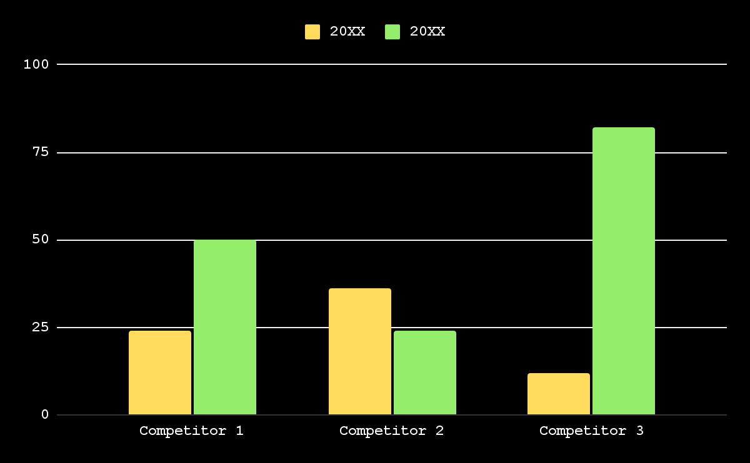
</New operating system design
20XX
Earth is the third planet from the Sun
20XX
Venus is the second planet from the Sun
Follow the link in the graph to modify its data and then paste the new one here. For more info, click here

Slide 32
</New operating system design
Venus
{01}
{02}
Mercury
It’s a hot planet
Mercury is small
Mars
{03}
{04}
Saturn
Mars is very cold
Saturn has rings
Earth
{05}
{06}
Neptune
Earth has life
It’s an ice giant
Jupiter
{07}
{08}
Pluto
Jupiter is big
It’s a dwarf planet

Slide 33
</New operating system design
Mercury
Venus
Earth
Jupiter
Saturn
Neptune
Earth is the planet with life
It doesn’t have a solid surface
It was named after a Roman god
Neptune is very far from us
40%
60%
20%
80%

Slide 34
</New operating system design
Venus
Mercury
{01}
{02}
It’s the second planet from the Sun
It’s the closest planet to the Sun
Earth
Mars
{03}
{04}
It’s the third planet from the Sun
Despite being red, Mars is very cold

Slide 35
</New operating system design
{10M}
Venus
Venus is a very hot planet
{1M}
Mars
Mars was named after a god
{10K}
Jupiter
Jupiter is a huge gas giant
{5K}
Saturn
Saturn has beautiful rings
{1K}
Neptune
Neptune is very far from us

Slide 36
</New operating system design
Our plans | Description | Price
Free | Mercury is the closest planet to the Sun Mercury is very small | $50
Freemium | Venus is the second planet from the Sun Venus is a hot planet | $75
Premium | Earth is the third planet from the Sun Earth is the planet with life We all live on Earth | $200

Slide 37
</New operating system design
{01}
{02}
{03}
Vision
Mission
Goals
Neptune is the farthest planet from the Sun
Saturn is composed mostly of hydrogen and helium
Despite being red, Mars is actually a cold place

Slide 38
</New operating system design
{50%}
Venus is the second planet from the Sun
{70%}
Mercury is the closest planet to the Sun
{10%}
Despite being red, Mars is very cold
{20%}
Jupiter is the biggest planet of them all
{90%}
Saturn was named after a Roman god

Slide 39
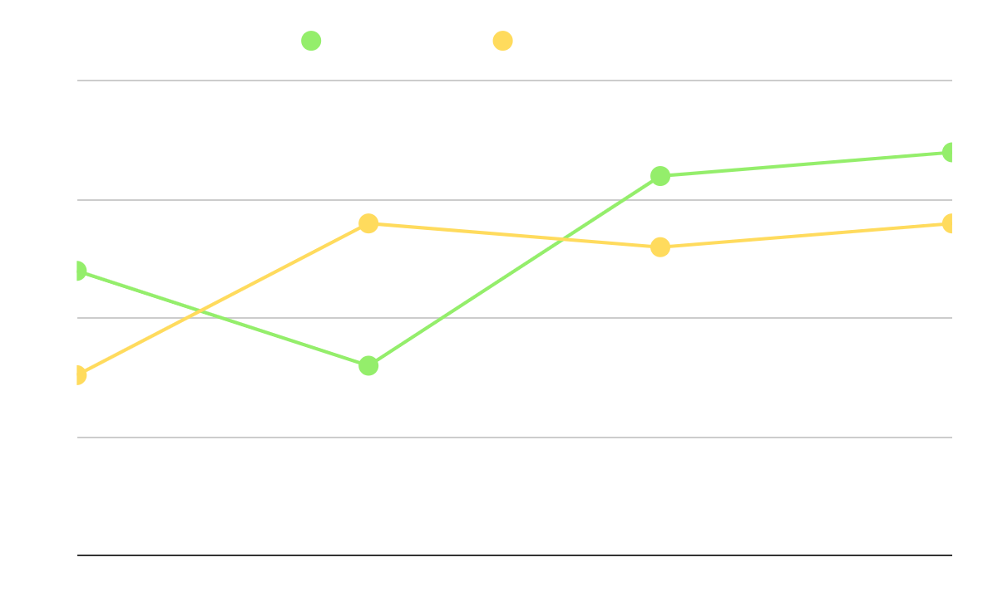
</New operating system design
Our company
Their company
Earth is the third planet from the Sun
Venus is the second planet from the Sun
Analysis
Saturn is a gas giant and has several rings. It’s composed mostly of hydrogen and helium
Follow the link in the graph to modify its data and then paste the new one here. For more info, click here

Slide 40
</New operating system design
{2/5}
By Mark Jones
{5/5}
By Timmy Jimmy
“Venus is the second planet from the Sun”
“Despite being red, Mars is very cold”
{4/5}
By Kim Williams
{3/5}
By Sue Lawson
“Jupiter doesn’t have a solid surface”
“Earth is the planet with life”

Slide 41
</New operating system design
Jupiter
It doesn’t have a solid surface
Mercury
Mercury is the closest planet to the Sun and the smallest of them all
Earth
Earth is the planet with life

Slide 42
</New operating system design
S
W
O
T
Strengths
Weaknesses
Opportunities
Threats
Earth is the planet with life
Jupiter is a huge gas giant
Mars is actually a cold place
Neptune is very far from us

Slide 43
</New operating system design
Brainstorming
Preparation
Facilitation
Venus is the second planet from the Sun
Despite being red, Mars is very cold
Follow through
Earth is the third planet from the Sun

Slide 44
</New operating system design
{01}
Awareness
Venus is a very hot planet
{02}
Interest
Mars was named after a god
{03}
Decision
Jupiter is a huge gas giant
{04}
Purchase
Saturn has beautiful rings

Slide 45
</New operating system design
 | Mon | Tue | Wed | Thu | Fri
Week 1 |  | Jupiter is a big planet
Week 2 |  |  | Mercury is a small planet
Week 3 |  |  |  |  | We all live on Earth
Week 4 | Neptune is an ice giant
</Jupiter
</Mercury
</Earth
</Neptune

Slide 46
</New operating system design
Budget model
It’s the closest planet to the Sun
It’s the second planet from the Sun
It doesn’t have a solid surface
Mercury
Venus
Jupiter
{30%}
{20%}
{50%}
{4,000,000}

Slide 47
</New operating system design
Mars was named after a god
Saturn has beautiful rings
Mars
Saturn
{20XX}
{20XX}
{20XX}
{20XX}
{20XX}
Venus
Jupiter
Earth
Venus is a very hot planet
Jupiter is a huge gas giant
It’s the planet with life

Slide 48
</New operating system design
Venus
Mars
It’s the second planet from the Sun
Despite being red, Mars is very cold
Earth
Jupiter
It’s the third planet from the Sun
It doesn’t have a solid surface

Slide 49
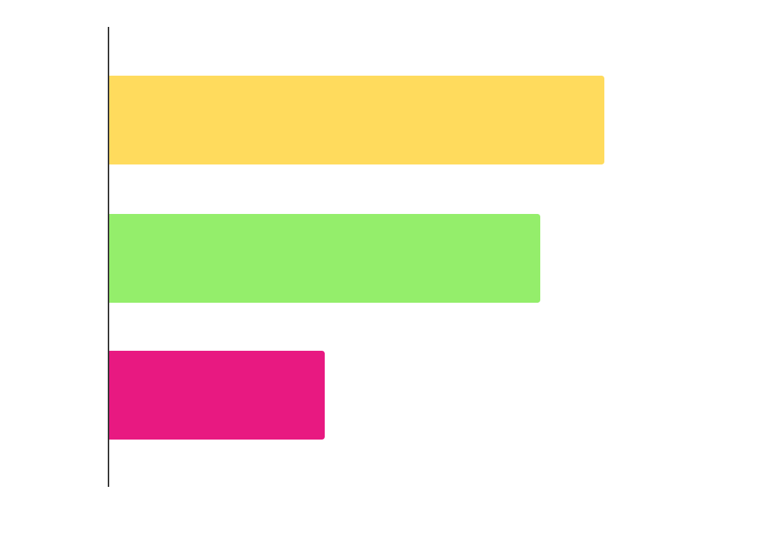
</New operating system design
{23K}
Mars
Mars was named after a god
{20K}
Venus
Venus is a very hot planet
{10K}
Jupiter
Jupiter is a huge gas giant
Follow the link in the graph to modify its data and then paste the new one here. For more info, click here

Slide 50
</New operating system design
Venus
{01}
Venus is a very hot planet
Mars
{02}
Mars was named after a god
Jupiter
{03}
Jupiter is a huge gas giant
Saturn
{04}
Saturn has beautiful rings

Slide 51
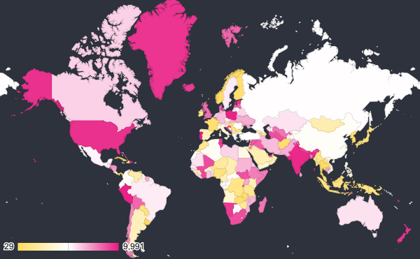
</New operating system design
Earth
Jupiter
Earth is the planet with life
It doesn’t have a solid surface
{4,000,000}
Saturn
It was named after a Roman god
Venus is the second planet from the Sun
Follow the link in the map to modify its data and then paste the new one here. For more info, click here

Slide 52
</New operating system design
Awards
Best team
Innovation
Experimental
Venus is the second planet from the Sun
Despite being red, Mars is very cold
Earth is the third planet from the Sun

Slide 53
</New operating system design
Mon | Tue | Wed | Thu | Fri | Sat | Sun
1 | 2 | 3 | 4 | 5 | 6 | 7
8 | 9 | 10 | 11 | 12 | 13 | 14
15 | 16 | 17 | 18 | 19 | 20 | 21
22 | 23 | 24 | 25 | 26 | 27 | 28
29 | 30
</Task 1
</Task 2
</Task 3
</Task 4

Slide 54
</New operating system design
Venus is the second planet from the Sun
Despite being red, Mars is actually a cold place
Earth is the planet on which we all live
Jupiter is the biggest planet in the Solar System
Venus
Mars
Earth
Jupiter
{01}
{02}
{03}
{04}

Slide 55
Instructions for use
If you have a free account, in order to use this template, you must credit Slidesgo in your final presentation. Please refer to the next slide to read the instructions for premium users.
As a Free user, you are allowed to:
- Modify this template.
- Use it for both personal and commercial projects.
You are not allowed to:
- Sublicense, sell or rent any of Slidesgo Content (or a modified version of Slidesgo Content).
- Distribute Slidesgo Content unless it has been expressly authorized by Slidesgo.
- Include Slidesgo Content in an online or offline database or file.
- Offer Slidesgo templates (or modified versions of Slidesgo templates) for download.
- Acquire the copyright of Slidesgo Content.
For more information about editing slides, please read our FAQs or visit our blog:
https://slidesgo.com/faqs and https://slidesgo.com/slidesgo-school

Slide 56
Instructions for use (premium users)
As a Premium user, you can use this template without attributing Slidesgo.
You are allowed to:
Modify this template.
Use it for both personal and commercial purposes.
Share this template in an editable format with people who are not part of your team.
You are not allowed to:
Sublicense, sell or rent this Slidesgo Template (or a modified version of this Slidesgo Template).
Distribute this Slidesgo Template (or a modified version of this Slidesgo Template) or include it in a database or in any other product or service that offers downloadable images, icons or presentations that may be subject to distribution or resale.
Use any of the elements that are part of this Slidesgo Template in an isolated and separated way from this Template.
Register any of the elements that are part of this template as a trademark or logo, or register it as a work in an intellectual property registry or similar.
For more information about editing slides, please read our FAQs or visit our blog:
https://slidesgo.com/faqs and https://slidesgo.com/slidesgo-school

Slide 57
Infographics
You can add and edit some infographics to your presentation to present your data in a visual way.
Choose your favourite infographic and insert it in your presentation using Ctrl C + Ctrl V or Cmd C + Cmd V in Mac.
Select one of the parts and ungroup it by right-clicking and choosing “Ungroup”.
Change the color by clicking on the paint bucket.
Then resize the element by clicking and dragging one of the square-shaped points of its bounding box (the cursor should look like a double-headed arrow). Remember to hold Shift while dragging to keep the proportions.
Group the elements again by selecting them, right-clicking and choosing “Group”.
Repeat the steps above with the other parts and when you’re done editing, copy the end result and paste it into your presentation.
Remember to choose the “Keep source formatting” option so that it keeps the design. For more info, please visit our blog.

